Slide 1
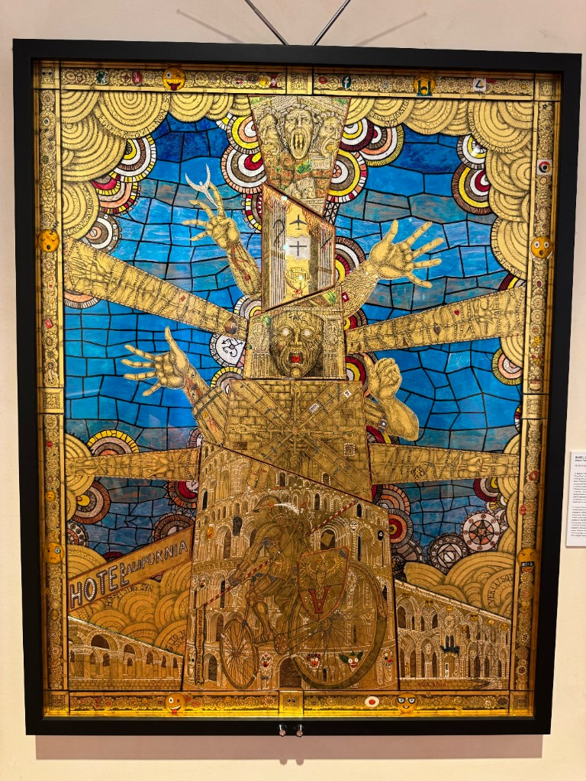
The Tower of Babel

Slide 2
Economics has built dozens of powerful computational toolkits — but they cannot talk to each other, and AI can finally give them a shared language.
Notes:
Welcome, everyone, and thank you for coming a day early. The theme of this afternoon is captured in one image. Economics has built an extraordinary collection of computational toolkits — heterogeneous-agent solvers, sequence-space methods, value-function iteration, agent-based models, dynamic CGE, deep-learning solvers. Each is powerful. But like the builders of Babel, we have ended up speaking mutually unintelligible languages: a model written for one toolkit usually has to be rebuilt from scratch to run in another. That fragmentation slows all of us down. The optimistic claim for today is that AI has finally made it realistic to give these tools a shared language — a common way to describe any economic model, with AI as the translator between them.

Slide 3
Today’s program — three sessions
1. How AI Can Solve the Tower of Babel Problem (now) — the opportunity, and why now is the moment.
2. Lessons from DYNARE — Sébastien Villemot on what the field’s most successful toolkit teaches us.
3. Lightning survey & discussion — each of you, about 5 minutes: from your toolkit’s vantage point, or on what a standards effort would need to succeed; then open floor.
Notes:
The afternoon has three sessions. First, right now, Akshay and I will lay out the Tower of Babel problem in more detail and why a common standard — plus AI — can solve it. Second, Sébastien Villemot will give us lessons from DYNARE, the one toolkit that genuinely unified a big part of our field, so we can learn what made it work. Third, after the coffee break, the heart of the meeting: a lightning survey where each of you speaks for about five minutes — from the vantage point of your own toolkit, or, if you are not from a toolkit, on what you think a standards effort would need to succeed — followed by open discussion.

Slide 4
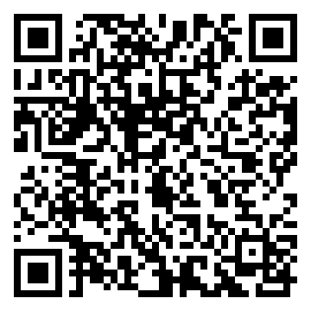
Working groups — we hope you will join one
Three standing SCE Working Groups, organized as layers:
WG1 — Language, Calculus & Formal Semantics (Chair: Akshay Shanker): the shared modeling language and its formal core.
WG2 — Methods, Backends & Verification (Chair: Herbert Dawid): interchangeable solution methods and “Rosetta Stones” between existing solvers.
WG3 — AI Assistance, Reproducibility & Standards (Chair: Alan Lujan): AI-assisted authoring and translation, robustness, and governance.
We hope every invited participant will join at least one group — and audience members are warmly welcome too. Sign up at a kiosk, or scan to join from your phone:
WG1

Slide 5
WG2 WG3
Notes:
Finally, this meeting is meant to start something that continues. We are forming three standing SCE Working Groups, organized as layers. WG1 is the shared modeling language and its formal core. WG2 is numerical methods and the Rosetta Stones that translate between existing solvers. WG3 is AI assistance, reproducibility, and the governance of the standard. We very much hope every invited participant will sign up for at least one group — and anyone in the audience is warmly welcome to join too. We will circulate the sign-up at the end. With that, let us begin.

